Slide 1

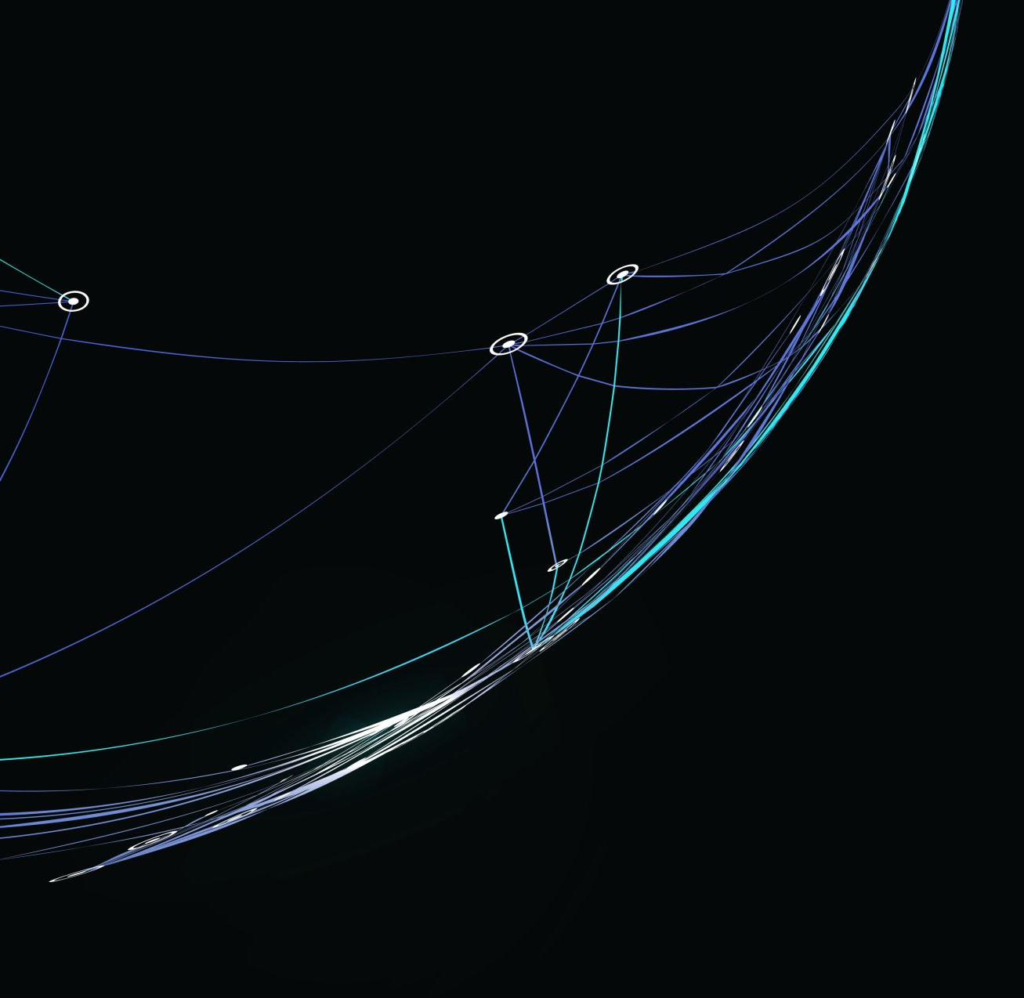
Sprint 2 Report
By Mitchell McCallum

Slide 2
Overview
Problem: US Telecoms company losing 4.16% of customers over roughly the span of a year
Lost Customers on average are 14.39% more profitable
Solution: Multiclass and multilevel Classification for telecom companies
Designed to enhance customer satisfaction and develop targeted retention strategies.
Notes:
Slide 1: Non-Technical Overview of Problem Statement, Solution, and Impact
Script: "This is my follow up presentation to talk about how I’ll be handling my dataset to predict churn in the telecom industry. Customer churn, or the tendency of customers to cease using a service, is a prevalent issue that can impact a company's growth and revenue. Our solution utilizes advanced machine learning techniques to predict not only which customers are likely to churn but also the reasons behind their decision. This multilevel classification approach enables telecom companies to implement targeted strategies for customer retention. The impact of this solution is substantial in this example we are looking at a potential to increase revenue by up to 4.5 percent. Additionally the customers that churn average 14.39 percent more profitable than the overall sample. By accurately identifying potential churn, we can enhance customer satisfaction, reduce acquisition costs, and ultimately, increase the company's profitability. This project has the potential to revolutionize customer retention strategies in the telecom sector."

Slide 3

Data Handling
Irrelevant Features/IDs
Handling Bad Data in target data set (Churn Reason)
Preprocessing
Encoding Text Variables
Balancing Churn categories
Class Under sampling
Synthetic Minority over sampling technique (SMOTE)
Notes:
Slide 2: Dataset Overview and Preprocessing Procedures
Script: "Our data set has a high count of features, this has proven to be create both opportunities and challenges as we have many irrelevant columns yet we have the user revenue divided into details of 5G & 4G revenue along with general profitability. For pre processing I have encoded variables with the data type of object as these variables can still be ranked. An important aspect of encoding our churn value is that we find we have a highly unbalanced data set, to address this 2 techniques will be used 1) a method called SMOTE: Synthetic Minority Over-sampling Technique SMOTE works by creating synthetic samples from the minority class by interpolating new instances between existing instances. The synthetic instances generated by SMOTE are used to balance the classes in the dataset, allowing the machine learning algorithm to learn from a more balanced dataset and make better predictions on the minority class. Next we have Undersampling that works by randomly selecting a subset of instances from the majority class so that the number of instances in the majority class is reduced to a level comparable to the number of instances in the minority class. This creates a more balanced dataset and allows the machine learning algorithm to learn from a less representative sample of the data.

Slide 4
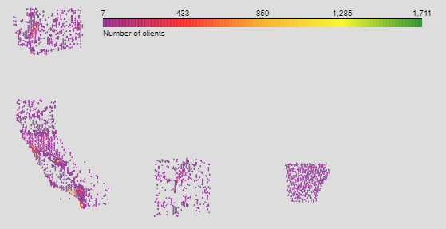
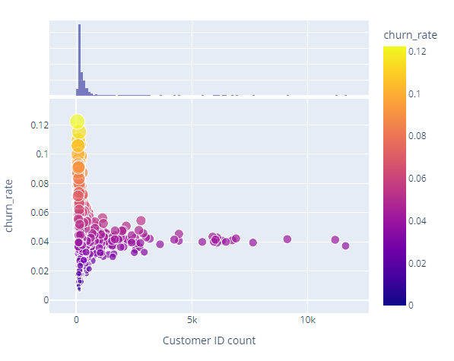
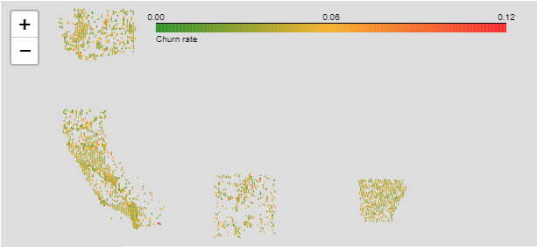
Customer Distribution and Churn Rate
Notes:
Slide 3: Key Findings from Exploratory Data Analysis (EDA)
Script: "Our exploratory data analysis revealed insightful trends and patterns. As you can see the density of service maps well across states with only New Mexico, that has a lot of desert within it’s borders, having sparsely geographic representation. Of Particular insight within the data set is the geographical data where density for the 4 States mapped showed density of customers consistent with urban centres yet in less dense areas we see a trend of higher churn rates, indicating that suburban or rural residents maybe consistently underserved. This data correlates somewhat with stated churn reason as “Service dissatisfaction” ranks 2nd amongst stated churn reasons."

Slide 5
Models and Metrics
Random Forest Decision Tree
Scoring Metrics
F1 Score
Recall Score
Confusion Matrix
ROC AUC score
Notes:
Slide 4: Baseline Models and Evaluation Metrics
Script: "Moving on to our predictive models - we established baseline models using techniques like decision trees and random forests and have been developed with an accuracy score of 95.74%. A deep neural network was also trained to the model but will need further refinement before we can get a satisfactory accuracy score. Our evaluation focused on metrics crucial for our problem - accuracy, F1 score, recall, and ROC AUC.
F1 score: the F1 score will be used as the class distribution for our churn categories.
Recall score: The recall score will be used as the cost of false negatives (missing customers likely to churn) is high. For example, in this project missing out on customers that are likely to churn is more important than misclassifying customers that arne't at risk of churn.
Confusion matrix: The confusion matrix is a versatile tool that can be used to visualize the performance of a model across different classes. It can be useful for identifying specific areas of the model that need improvement. As this project will be used in an iterative manner, it will be important to optimize the model by analyzing previous models' failures.
ROC AUC score: the ROC AUC score will be used as it's ability to distinguish between positive and negative classes is important. Ideally we would like to have the clearest picture possible in terms of a customer's likelihood of churn so as to not needlessly waste resources on customers that don't churn and properly identify customers with a good risk of churn.
These metrics help us gauge not just the model's accuracy but also its ability to detect churn accurately. The initial results were promising, laying a strong groundwork for more advanced modeling."

Slide 6

Future work
Gradient Boosting => XGBoost
Hyperparameter tuning
Deep Neural Network
Multilevel, Multilabel Classification
Multilabel Binarizer
Train a deeper multi-layer perceptron
Refinement of Data Preprocessing to ensure no leakage and Drift
Notes:
Slide 5: Next Steps for Advanced Modeling and Productizing the Work
Script: "As we look ahead, our journey continues towards enhancing our models with more sophisticated techniques like gradient boosting and deep learning. Our goal is to refine our predictions and make the model robust for real-world application. I will be looking into refining the encoding process as so far it has been determined that the parameters for the algorithms aren’t creating problems. Creating a model with XGBoost is also a goal. I will also be seeing if I can vectorize our categories to get a sense for the predictive capabilities of the feedback to rank importances of the reasons for more tangible operations advice."

